Slide 1

Git - Life Cycle
Clone the git repository as a working copy.
1
Modify the working copy by adding/editing files.
2
If necessary, also update the working copy by taking other developer's changes.
3
Review the changes before commit.
4
Commit changes. If everything is fine, then push the changes to the repository.
5
After committing, if something is wrong, then correct the last commit and push the changes to the repository.
6

Slide 2
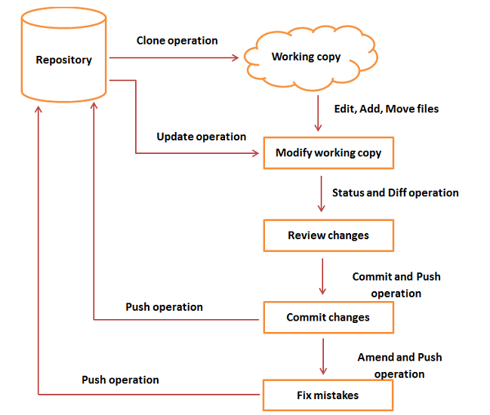

Slide 3

GITHUB
GitHub is a code hosting platform for collaboration and version control.
GitHub lets you (and others) work together on projects.
GitHub essentials are:
Repositories
Branches
Commits
Pull Requests
Git (the version control software GitHub is built on)

Slide 4
Repository
A GitHub repository can be used to store a development project.
It can contain folders and any type of files (HTML, CSS, JavaScript, Documents, Data, Images).
A GitHub repository should also include a license file and a README file about the project.
A GitHub repository can also be used to store ideas, or any resources that you want to share.

Slide 5
Branch
A GitHub branch is used to work with different versions of a repository at the same time.
By default a repository has a master branch (a production branch).
Any other branch is a copy of the master branch (as it was at a point in time).
New Branches are for bug fixes and feature work separate from the master branch. When changes are ready, they can be merged into the master branch. If you make changes to the master branch while working on a new branch, these updates can be pulled in.
Commits
At GitHub, changes are called commits.
Each commit (change) has a description explaining why a change was made.

Slide 6
Pull Requests
Pull Requests are the heart of GitHub collaboration.
With a pull request you are proposing that your changes should be merged (pulled in) with the master.

Slide 7
Open an account in GitHub

Slide 8
To create a new repository
1. In the upper right corner, next to your avatar or identicon, click + and then select new repository.
2. Name your repository hello-world1.
3. Write a short description.
4. Select Initialize this repository with a README.

Slide 9
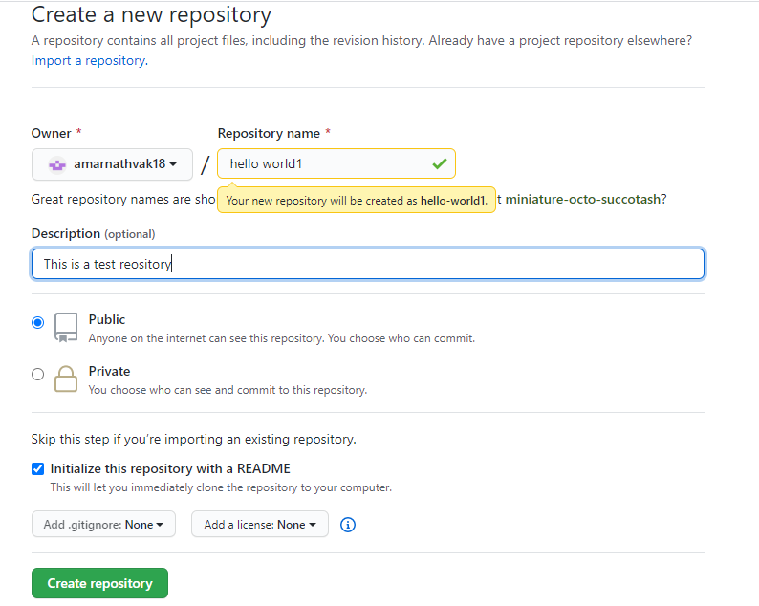

Slide 10
To create a new branch
1. Go to your new repository hello-world.
2. Click the drop down at the top of the file list that says branch: master.
3. Type a branch name, INB-1, into the new branch text box.
4. Select the blue Create branch box or hit “Enter” on your keyboard.

Slide 11
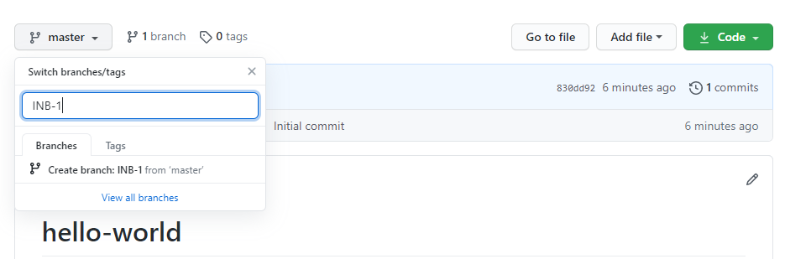

Slide 12
Make and commit changes
Click the readme.md file.
Click the pencil icon in the upper right corner of the file view to edit.
In the editor, write a bit about yourself.
Write a commit message that describes your changes.
Click Commit changes button.
These changes will be made to just the README file on your INB-1 branch, so now this branch contains content that’s different from master.

Slide 13
Open a Pull Request
Nice edits! Now that you have changes in a branch off of master, you can open a pull request.
Pull Requests are the heart of collaboration on GitHub. When you open a pull request, you’re proposing your changes and requesting that someone review and pull in your contribution and merge them into their branch. Pull requests show diffs, or differences, of the content from both branches. The changes, additions, and subtractions are shown in green and red.
As soon as you make a commit, you can open a pull request and start a discussion, even before the code is finished.
You can even open pull requests in your own repository and merge them yourself. It’s a great way to learn the GitHub flow before working on larger projects.
Open a Pull Request for changes to the README
When you’re done with your message, click Create pull request!

Slide 14
Merge your Pull Request
In this final step, it’s time to bring your changes together – merging your INB-1 branch into the master branch.
1. Click the green Merge pull request button to merge the changes into master.
2. Click Confirm merge.
3. Go ahead and delete the branch, since its changes have been incorporated, with the Delete branch button in the purple box.

